Slide 1

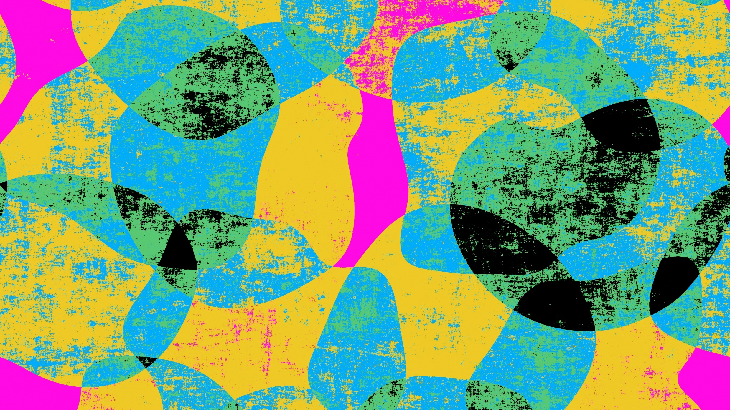
HeirNFT
Algorand Greenhouse Hack III Pitch Deck
(Codeless Bounty)

Slide 2
NFT Timeline for Algorand Marketplace
2022
When NFT started on Algorand (Past)
2023
Where we presently are using NFT on Agorand (Present)
2024
What we hope to achieve at the end of the year (Future)

Slide 3
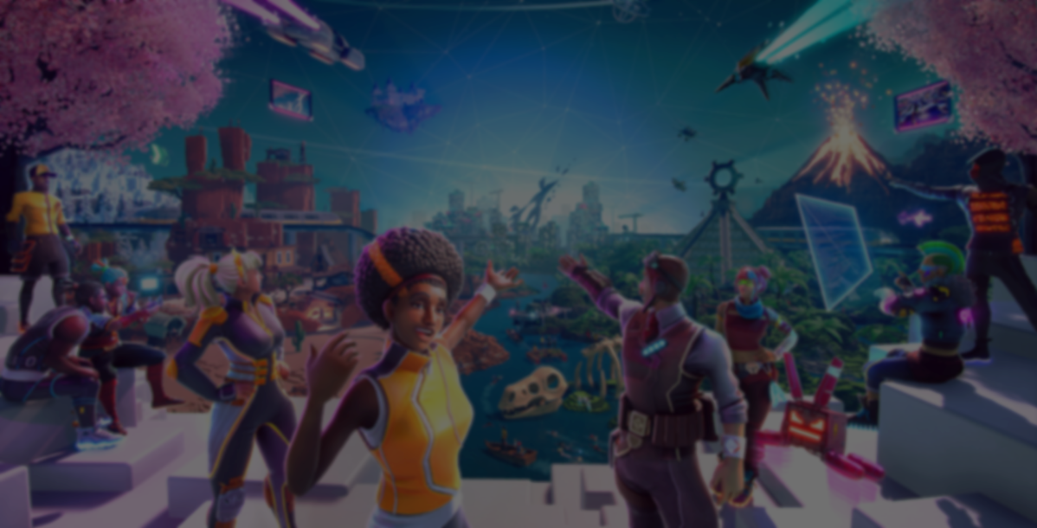
What is HeirNFT?
HeirNFT is a competition that will be hosted on the Algorand website such that anyone who enters the site will see the competition. This will in turn boost the number of new members and traffic on the website. The competition will be open to all artists, businesses and collectors who are interested in digital ownership and scarcity.

Slide 4

Our Goals
Grow the Algorand NFT awareness and marketplace, getting people excited about what Algorand has to offer
Attract more artists, businesses and collectors thereby increasing the social media awareness & building up some ‘hype’.

Slide 5
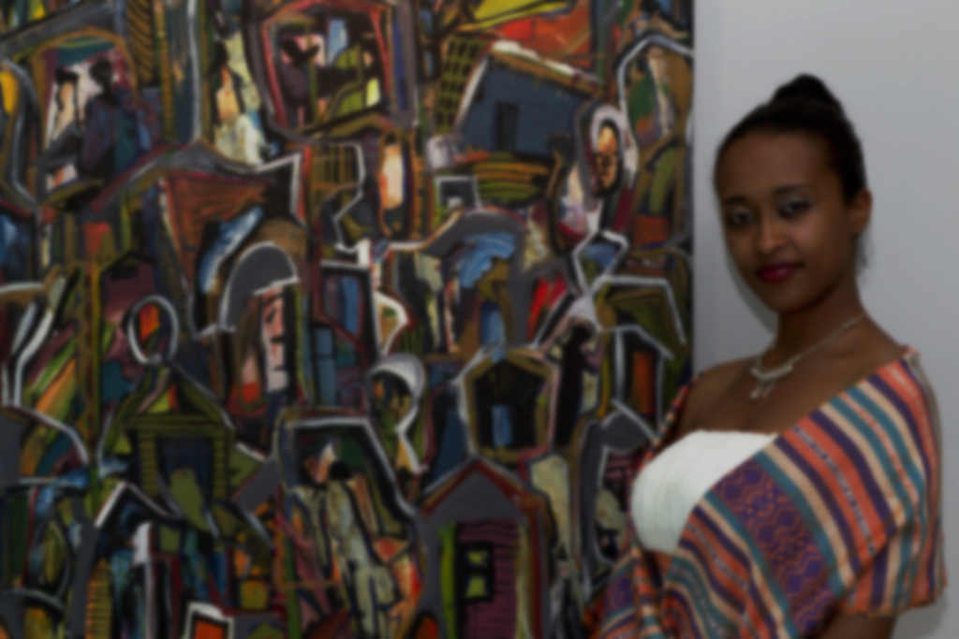
Target Market
The target market for the Algorand NFT space includes both individuals and businesses that are interested in buying, selling, or creating NFTs. This includes artists, collectors, gamers, and anyone else interested in digital ownership and scarcity.

Slide 6
Product Description
NFT COMPETITION

Slide 7
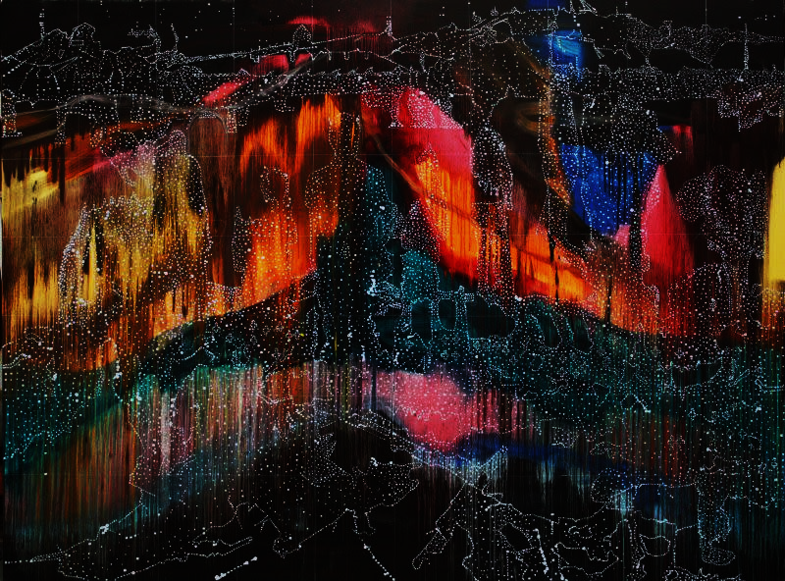
How it Works
HeirNFT is a competition that will see artists create original NFTs (non-fungible tokens) and NFT collections that represents a unique and creative interpretation of the concept, "Treasures in Trashes". The NFT can be in the form of a digital artwork, animation, or even a short film.

Slide 8
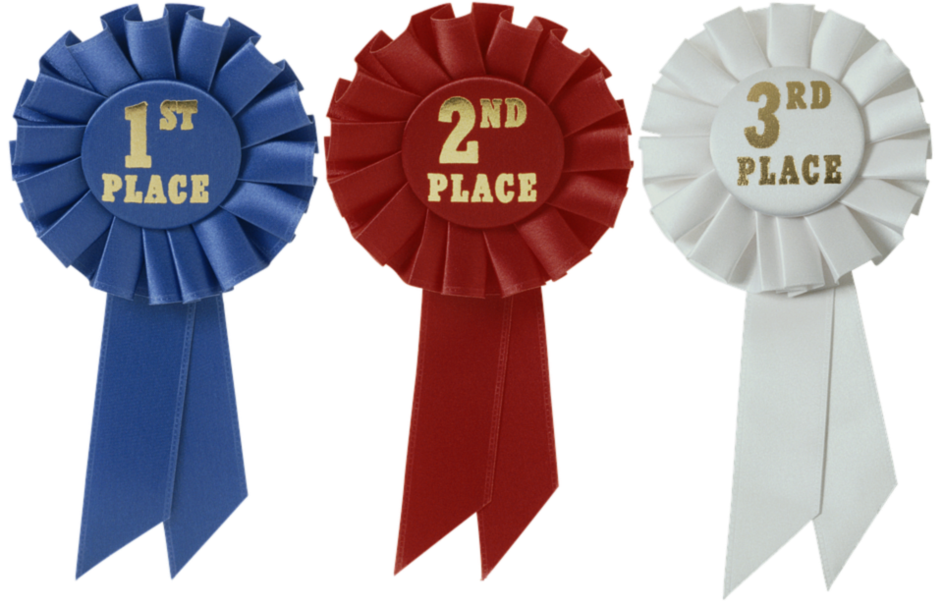
Prizes
The winner, 1st runner up and 2nd runner up will be
a feature in a well-known NFT publication or website,
a cash prize, and
a chance to showcase and sell their collection at a virtual exhibition or event.
In addition to these, the winner gets an exclusive invite and an all-expense paid trip to the next Algorand event.
Also, everyone who signed up for the competition will receive an “NFT of Participation” in their wallet.

Slide 9


Slide 10

Social Media Platforms
Twitter: to share updates, engage with the community through Twitter Spaces, interact with Twitter Influencers to spread the word about the event and secure partners' engagement with our Tweets (RT, like, Quote Tweets) to maximize reach
Telegram: can be used to have direct communication with the community and build a loyal fan base
Reddit and Medium: Articles will be written here to build a community of NFT enthusiasts and share educational resources about HeirNFT, how it works, rules and the prizes

Slide 11

On Discord, specific channels would be created solely for the HeirNFT competition. All information and announcement would be made here
Instagram: to showcase NFT projects and connect with influencers and industry leaders
LinkedIn: to connect with professionals in the industry and share industry updates.
And since the event holds on the Algorand website, more awareness and traffic would be generated from visiting their websites.

Slide 12

Budget
Product Expense | Estimated Price
Website Rebranding | $25,000
Development of NFT Marketplace | $30,000
Community Building | $15,000
Marketing and Advertisements | $20,000
Competition Prizes including the NFT of Participation | $30,000
Total | $120,000

Slide 13
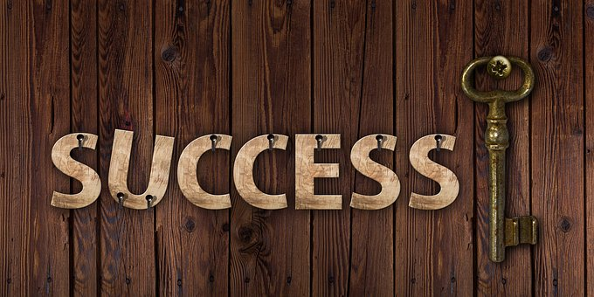
Measurement of Success
Success will be measured in a variety of ways which will include:
Number of NFTs created and sold on the Algorand blockchain
Number of users on the NFT marketplace
Number of community members and engagement rate
Number of partnerships and collaborations established
Number of transactions and volume on the NFT marketplace
Increase in awareness and understanding of NFTs and Algorand
Feedbacks from artists, collectors and businesses will be taken for improvement purposes
Overall revenue generated from the NFT space on Algorand.

Slide 14


